Slide 1

MNEs operations and global integration of production and R&D:
the case of Menarini Group as a global Pharmaceutical player
Giovanni Ricci Armani
Global Head of ESG and Risk Management
Corporate Director of Consolidated Statements, Tax & Grants
16th June 2026
Slide 1 of 17

Slide 2



Pharmaceutical Industry Strategic Value for Italy
PRODUCTION
EXPORT
EMPLOYMENT
R&D (2024)
74 billion
2% of GDP
including indirect impact
(public pharmaceutical expenditure 1% of GDP)
1st in the UE for CDMO
69 billion
75% of total Italy export growth 2025
11,3% (2025) vs 4% (2005)
(% of total manufacturing)
72.200
2019-2025
+10% total
+25% under 35
306 thousand employees including related industries and supply chain
4 billion
in R&D and production
+43% over five years
Contract Development
And Manufacturing Organization
Source: FARMINDUSTRIA_2025
Slide 2 of 17

Slide 3


Menarini
was founded in 1886.
In 1915 its headquarters
were established
in Florence.
Slide 3 of 17

Slide 4

Milestones
1886
1964
1978
1992
Menarini foundation
International presence
The internationalization of Menarini begins with the opening of Laboratorios Menarini in Spain, followed on by Greece, Portugal, Central America and France.
Research & Development
Menarini’s Research & Development department opened and patents on pharmaceuticals were introduced.
Central and Eastern Europe
Menarini acquires ex-GDR company Berlin-Chemie thanks to which it makes its entry into Germany and Central and Eastern Europe.
Since 1992, the Menarini Group has reinvested all profits in its growth
Slide 4 of 17

Slide 5

Milestones
2003
2011
2020
2023
Menarini Biotech
Opening of Menarini Biotech, specialised in the research, development and manufacturing of biotech pharmaceuticals,
from the lab to the patient.
Asia Pacific
Menarini makes its entry into Asia Paciﬁc thanks to the acquisition of a company based in Singapore and present in
13 countries throughout the region, from China to Australia.
U.S.A.
Menarini makes its entrance into the USA through to the acquisition of Stemline Therapeutics, biopharmaceutical company publicly listed on NASDAQ, and their product Tagraxofusp, the only FDA approved therapy available for BPDCN, thus strengthening Menarini’s presence in oncology.
FDA & EMA
U.S. FDA and EU (EMA) approve Elacestrant as the first treatment for patients with ER+/HER2-, ESR1 mutated advanced or metastatic breast cancer.
Slide 5 of 17

Slide 6





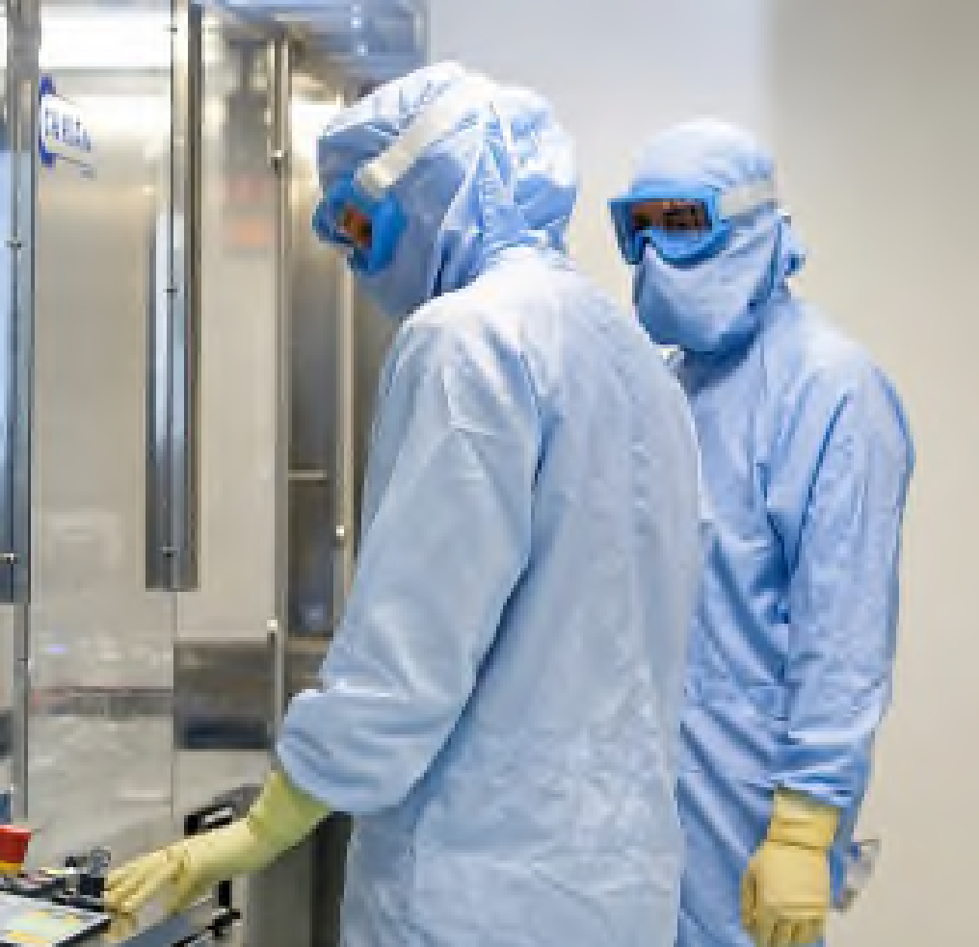

Menarini Group
Present in
140 countries worldwide
4,887
million €
consolidate turnover
81% International
19% Italy
17,800
employees
(with its affiliates, distributors and franchises)
9
R&D centers
18
Manufacturing plants
540
million €
in R&D investments
Source: Internal Data
Slide 6 of 17

Slide 7
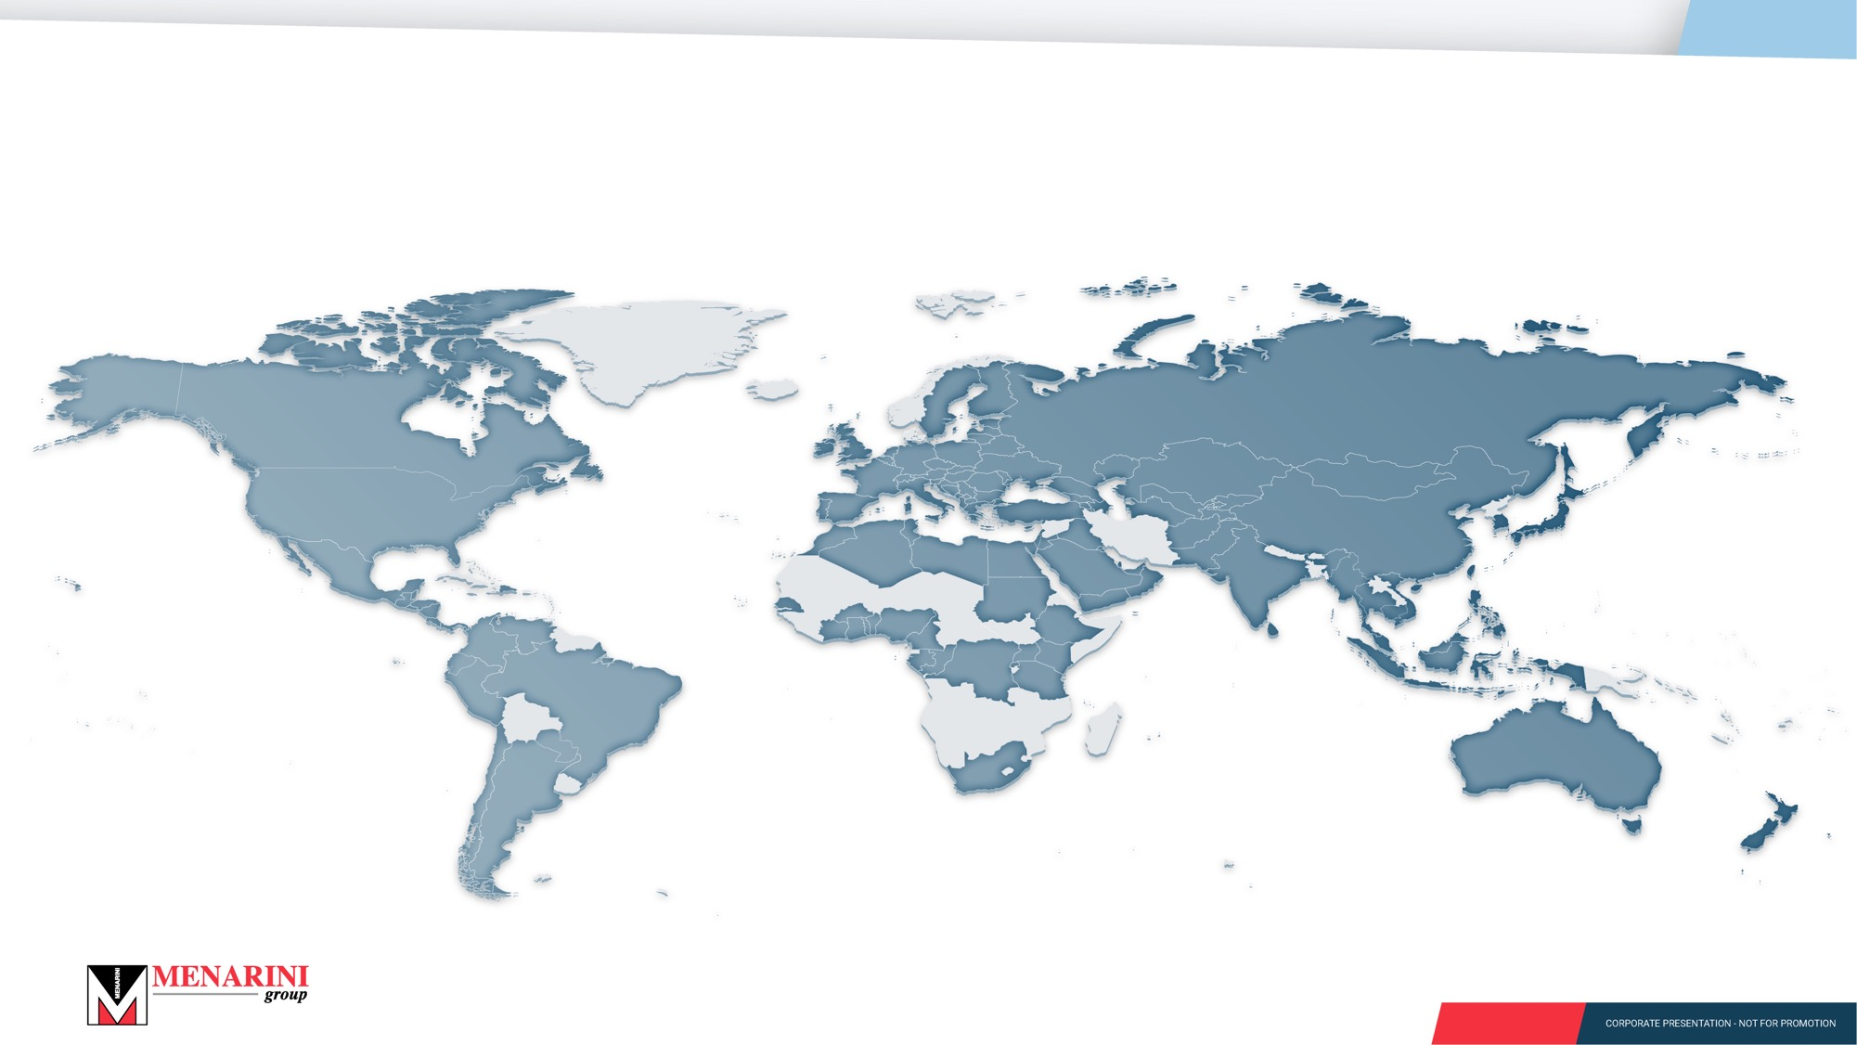
Menarini in the world
Present in 140 countries worldwide (with its affiliates, distributors and franchises)
Slide 7 of 17

Slide 8

Consolidated turnover
Pharmaceutical
97%
International
81%
Diagnostic
3%
Italy
19%
Source: internal data
Slide 8 of 17

Slide 9
Menarini Group: Therapeutic Areas
WORDWIDE
Others
Cardiovascular
Gastro
9,9%
27,3%
6,8%
Pain
10,9%
Diabetes
11,8%
Respiratory
Oncology
17,7%
15,5%
Slide 9 of 17

Slide 10
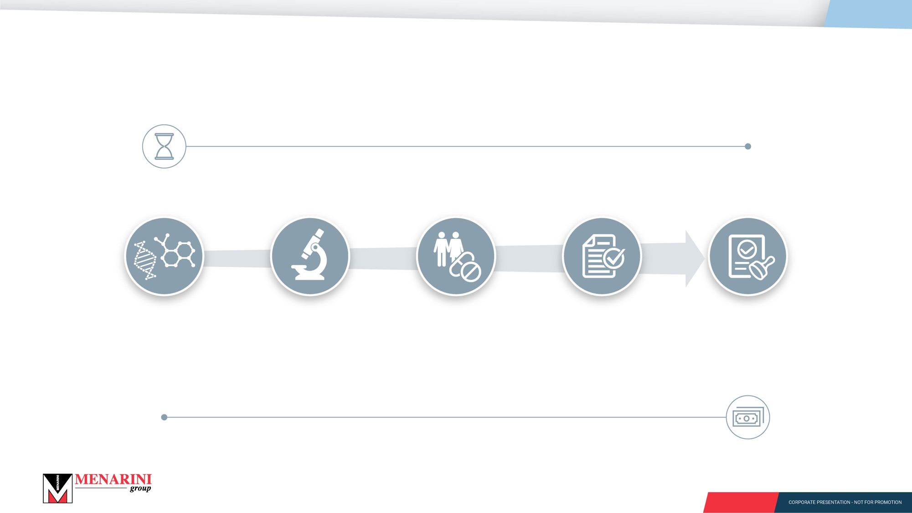
The process that leads to new medicines
Up to 10 years¹
DRUG
DISCOVERY
PRECLINICAL
DEVELOPMENT
CLINICAL
DEVELOPMENT
REGULATORY
APPROVAL
MARKETING
AUTHORIZATION
Identification of new
active ingredients
Patent
Study of the investigational drug non-clinical safety and efficacy profiles
Dosage form selection (tablets, vials, etc.)
Possible additional patent
Clinical phase I
Clinical phase II
Clinical phase III
Possible additional patent
Submission of the drug’s dossier to Regulatory Authorities
Release of marketing authorization by Regulatory Authorities
Product Launch
Up to 2.6 billion dollars¹
Only 9%–12% of molecules that successfully pass the preclinical phase reach commercialization
1. Di Masi et al. Journal of Health Economics 47 (2016) 20-33
Slide 10 of 17

Slide 11

9 Research & Development centers
Barcelona
New York
Philadelphia
Florence
Pisa
Rome
Bologna
*
Berlin
Singapore
* Pomezia
Slide 11 of 17

Slide 12
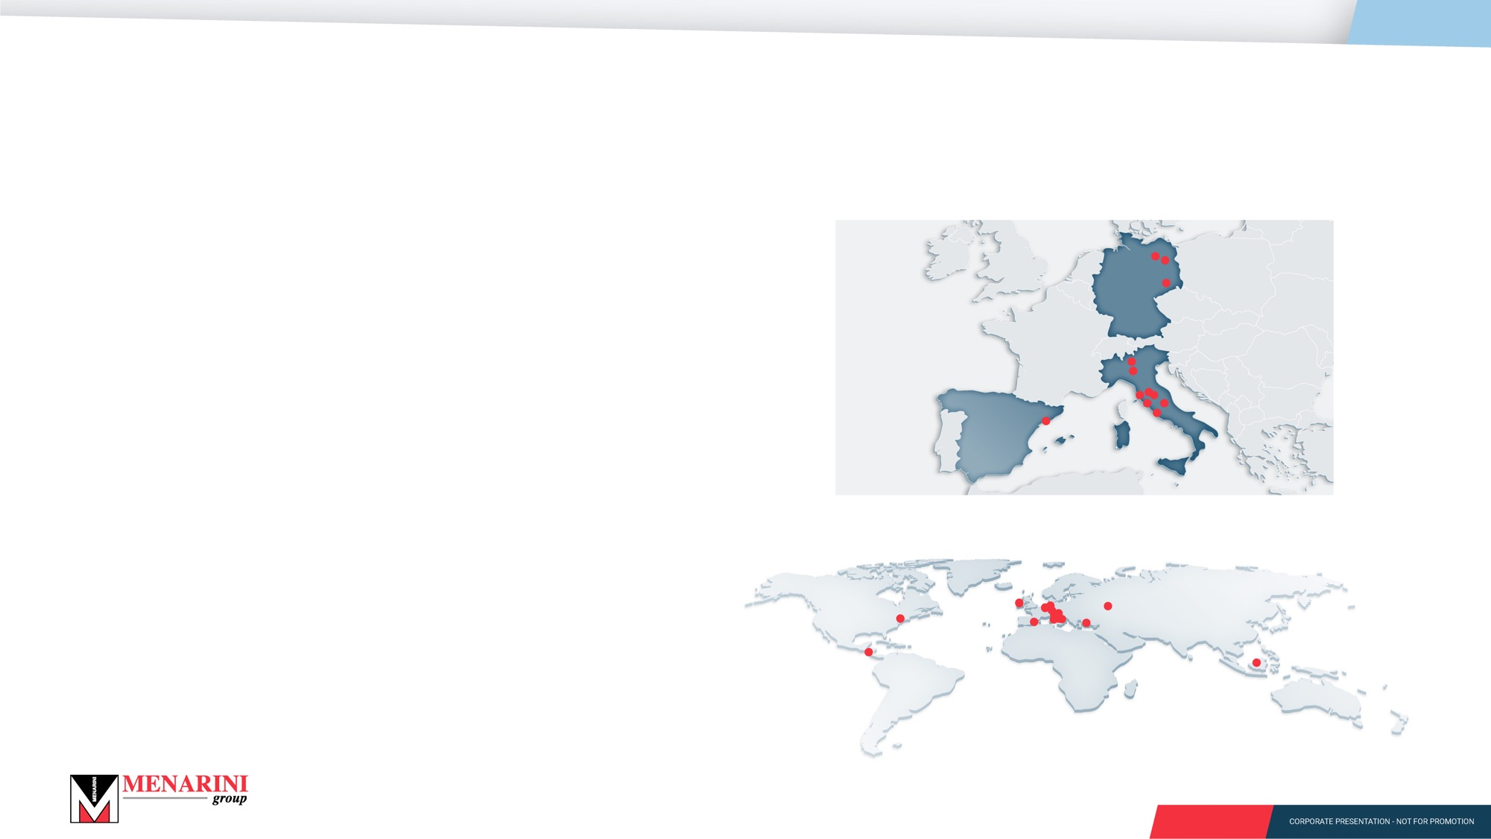
18 manufacturing plants
EUROPE is the Group’s heart of production
*
Italy Pisa (2 plants), Florence (2 plants)
Pomezia**, L'Aquila, Lomagna (Lecco),
Casaletto Lodigiano (Lodi)
Spain Barcelona
Germany Berlin (2 plants), Dresden
Plants dedicated to the production for local markets are located in Central America (Guatemala City), Ireland (Shannon), Turkey (Istanbul), Russia (Kaluga) and Indonesia (Jakarta)
U.S.A. (Philadelphia - Huntingdon Valley): diagnostic production
* Plants dedicated to the production for global markets
** Biotech manufacturing with development and production processes also for third parties
Slide 12 of 17

Slide 13
Menarini’s Organizational Structure and Regional Presence
While the Oncology business is an independent organizational unit, headquartered in the US, the rest of the pharmaceutical business, also known as Primary and Specialty Care, is organized into four regional hubs:
- Western Europe, the Middle East, and Africa (WEMEA), which is headquartered in Florence, Italy;
- Germany and Central+Eastern Europe, headquartered in Berlin;
- Spain and Latin America, headquartered in Barcelona;
- Asia-Pacific, headquartered in Singapore.
R&D, Manufacturing, Scientific Medical Information and Sales are highly integrated functions that work at the global, regional and local level.
Intangibles’ ownership is centered within four regional hub entities situated in Italy, Germany, Spain and Singapore. Functioning as entrepreneurs, these organizations source manufacturing and R&D services to supply products to local distributors. These local distributors operate as co-entrepreneurs, contributing a vital competitive advantage through their specialized medical information services.
Slide 13 of 17

Slide 14
Example#1 single-region product
A promising product is identified for exclusive exploitation within the Central-Eastern Europe territory;
Intellectual Property (IP) rights are obtained by a German subsidiary from a licensor, who retains the rights for territories outside the region. Compensation generally consists of a combination of upfront payment, milestone payments, and royalties;
In cases where the product is in development stages (eg preclinical or clinical phases 1, 2 or 3), the parties establish mutual obligations for the execution of subsequent R&D activities required to produce robust clinical data. Menarini Ricerche SpA has the expertise to conduct those R&D activities, if needed, on a service basis and at the German entity's risk;
Slide 14 of 17

Slide 15
Example#2 multi-region product
A promising product is identified for exclusive exploitation across two or more regions (eg the Western Europe and Central-Eastern Europe territory);
Intellectual Property (IP) rights are obtained by an EU subsidiary specialized in IP Protection and sub-licensed out to the Italian entity and the German Entity for exploitation in the respective territories;
The EU entity, the Italian entity and the German entity establish mutual obligations commensurate to their risks and rewards.
Slide 15 of 17

Slide 16
Example#3 Oncology product
A promising product is identified for exclusive exploitation world-wide;
Intellectual Property (IP) rights are obtained by a US subsidiary from a licensor.
The US subsidiary performs the clinical development activity to bring the product to market, using own workforce plus workforce sourced from Italian and German subsidiaries
Manufacturing for the US market is usually a US CMO
For Europe a blister is required so the bulk is shipped to Germany where the finished product is packaged and shipped to a Logistic Provider (3rd party)
A Dutch entity performs the import from the US and exports to other subsidiaries which perform the medical-marketing activities and bill the final client for the goods
The Logistic Provider physically receives the goods and moves them across countries, before shipment directly to the hospitals. Its P&L records only a service fee rather than "purchases“ and “sales”. Consequently, institutional financial metrics — derived from profit and loss statements and trade flows records — may show discrepancies.
Slide 16 of 17

Slide 17
Slide 17 of 17

Slide 18

Research & Development Projects
ONCOLOGY
SOLID TUMORS |  | COMPOUND | DRUG CLASS (TARGET) | INDICATION | DEVELOPMENT STAGE
 |  | Elacestrant° | SME (SERD - ER) | Monotherapy: ER+/HER2- Metastatic Breast Cancer (EMERALD trial) | EMA and FDA: approved
 |  | Elacestrant | SME (SERD - ER) | Monotherapy: CDK4/6 Inhibitor-naïve ER+/HER2- Metastatic Breast Cancer (ELCIN trial) | Phase II
 |  | Elacestrant | SME (SERD - ER) | Combination therapy: ER+/HER2- Metastatic Breast Cancer (ELEVATE trial) | Phase II
 |  | Elacestrant | SME (SERD - ER) | Combination therapy: ER+/HER2- Breast Cancer with brain metastasis (ELECTRA trial) | Phase II
 |  | Elacestrant | SME (SERD - ER) | Combination therapy: ER+/HER2- Metastatic or locally Advanced Breast Cancer (SUMIT-ELA trial)* | Phase II
 |  | Elacestrant | SME (SERD - ER) | Combination therapy: ER+/HER2- , ESR-1 mut, Advanced Breast Cancer (ADELA trial)** | Phase III
 |  | Elacestrant | SME (SERD - ER) | Monotherapy: ER+/HER2− early Breast Cancer with a high risk of recurrence (ELEGANT trial) | Phase III
 |  | SL-701 | IT (IL-13Rα2, EphA2, Survivin) | Recurrent Glioblastoma | Phase II
 |  | MEN1309 | ADC (Anti-CD205) | Solid Tumors | Phase Ib
 |  | MEN2312 | SME (KAT6i) | Breast Cancer/Solid Tumors and HEME malignancies | Phase I
 |  | Selinexor | SME (XP01i) | Endometrial Cancer*** | Phase III
 |  | MEN2501 | SME (KIF18Ai) | Ovarian Cancer | Phase I
 |  | MEN2602 | Biologic | Multiple Tumors | Pre-clinical
HEMATOLOGY |  | COMPOUND | DRUG CLASS (TARGET) | INDICATION | DEVELOPMENT STAGE
 |  | Tagraxofusp | TB (CD123) | Monotherapy: Blastic plasmacytoid dendritic cell neoplasm (BPDCN) | EMA and FDA: approved
 |  | Tagraxofusp | TB (CD123) | Monotherapy: Chronic myelomonocytic leukemia (CMML) | Phase II
 |  | Tagraxofusp | TB (CD123) | Monotherapy: Myelofibrosis (MF) | Phase II
 |  | Tagraxofusp | TB (CD123) | Combination therapy: Acute Myeloid Leukemia (AML) | Phase II
 |  | Dapolsertib | SME (PIM/FLT3i) | Monotherapy: Relapsed/refractory Diffuse Large B-cell Lymphoma (DLBCL) | Phase II
 |  | Selinexor°° | SME (XPO1i) | Combination therapy: Relapsed/refractory Multiple Myeloma*** | EMA and FDA#: approved
 |  | Selinexor | SME (XPO1i) | Combination therapy: Myelofibrosis*** | Phase III
° https://www.menarini.com/en-us/news/news-detail/european-commission-approves-menarini-groups-orserdu174-elacestrant-for-the-treatment-of-patients-with-er-her2-locally-advanced-or-metastatic-breast-cancer-with-an-activating-esr1-mutation
* In collaboration with Carrick Therapeutics
** In co-sponsorship with MedSir
*** Karyopharm trial. Based on the Licensing agreement in force, Menarini has Exclusive Rights to Commercialize NEXPOVIO for the Treatment of Hematologic and Solid Tumor Oncology Indications in Europe (including the United Kingdom), Latin America and Other Key Countries
°° https://www.menarini.com/en-us/news/news-detail/karyopharm-and-menarini-receive-full-marketing-authorisation-from-the-european-commission-for-nexpovio174-selinexor-for-the-treatment-of-patients-with-multiple-myeloma-after-at-least-one-prior-therapy.html
# Commercialized by the Licensor: Karyopharm Therapeutics
SERD, Selective Estrogen Receptor Degrader; IT, Immunotherapy; SME, Small Molecule Entity; ADC, Antibody Drug Conjugate.; TB, Targeted Biologic; SME, Small Molecule Entity

Slide 19

Research & Development Projects
ANTI-INFECTIVES
COMPOUND | DRUG CLASS | INDICATION | DEVELOPMENT STAGE
Meropenem + Vaborbactam | Carbapenem + β-lactamase inhibitor | Complicated urinary tract infections, Complicated Intra abdominal infections, Hospital acquired pneumonia, Ventilator associated pneumonia and Bacteremia | EMA, FDA*, Hong Kong, Malaysia, Singapore, Thailand, Macao, Switzerland: approved
Delaﬂoxacin | Anionic ﬂuoroquinolone | Acute Bacterial Skin and Skin Structure - ABSSSI Community Acquired Bacterial Pneumonia - CABP | EMA, FDA*, Hong Kong, Switzerland, TITCK (Turkey): approved
Oritavancin | Semisynthetic glycopeptide | Acute Bacterial Skin and Skin Structure - ABSSSI | EMA, FDA*, Switzerland: approved
Oritavancin (1 vial formulation) | Semisynthetic glycopeptide | Acute Bacterial Skin and Skin Structure - ABSSSI | EMA, FDA*, Switzerland: approved
* Commercialized by the Licensor: CorMedix

Slide 20
Research & Development Projects
CARDIO-METABOLIC
COMPOUND | DRUG CLASS | INDICATION | DEVELOPMENT STAGE
Obicetrapib | Cholesteryl ester transfer protein (CETP) inhibitor | Lipid Lowering agent administered to patients previously treated with Maximum Tolerated Lipid-Modifying Therapies not at target for LDL-C | Phase III completed, under EU review
 |  | Prevention of Major Adverse CardioVascular events | Phase III
Obicetrapib+Ezetimibe | Cholesteryl ester transfer protein (CETP) inhibitor + Niemann-Pick C1-like 1 (NPC1L1) protein inhibitor | Lipid Lowering agent administered to patients treated with Maximum Tolerated Lipid-Modifying Therapies not at target for LDL-C | Phase III completed, under EU review
https://www.menarini.com/en-us/news/news-detail/newamsterdam-pharma-and-the-menarini-group-sign-licensing-deal-to-commercialize-obicetrapib-in-europe

